Slide 1
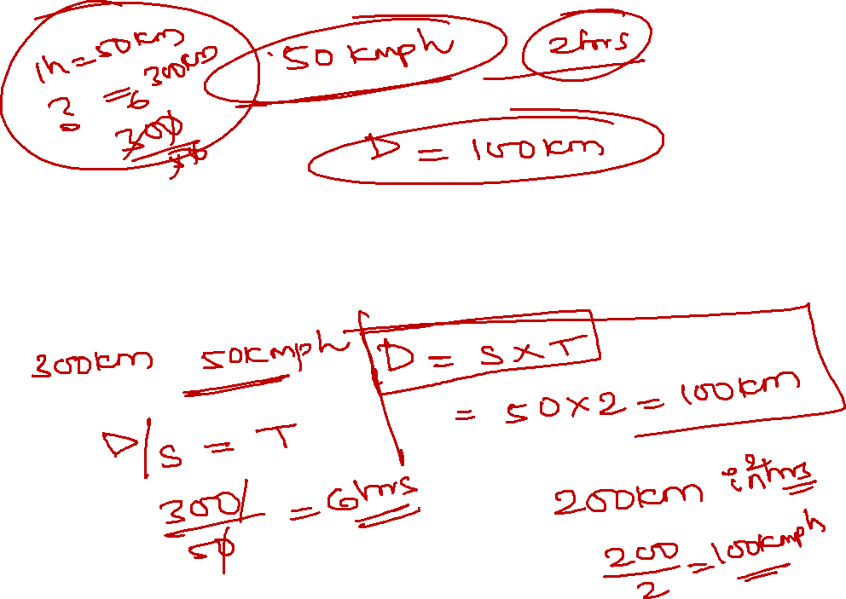
Time speed distance
Quantitative Aptitude

Slide 2
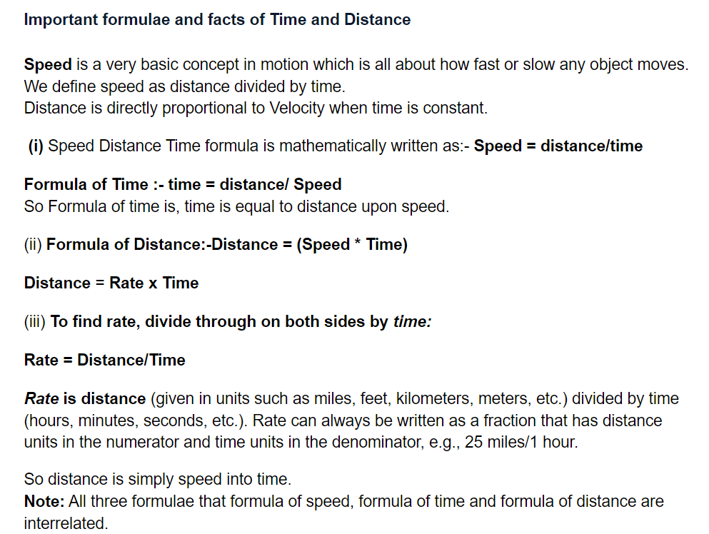
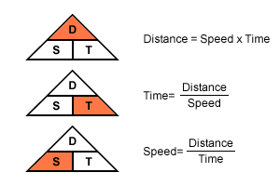
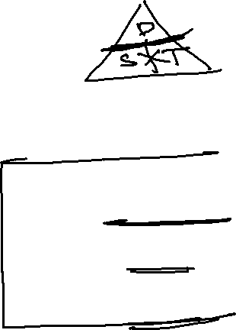
Time speed distance:

Slide 3
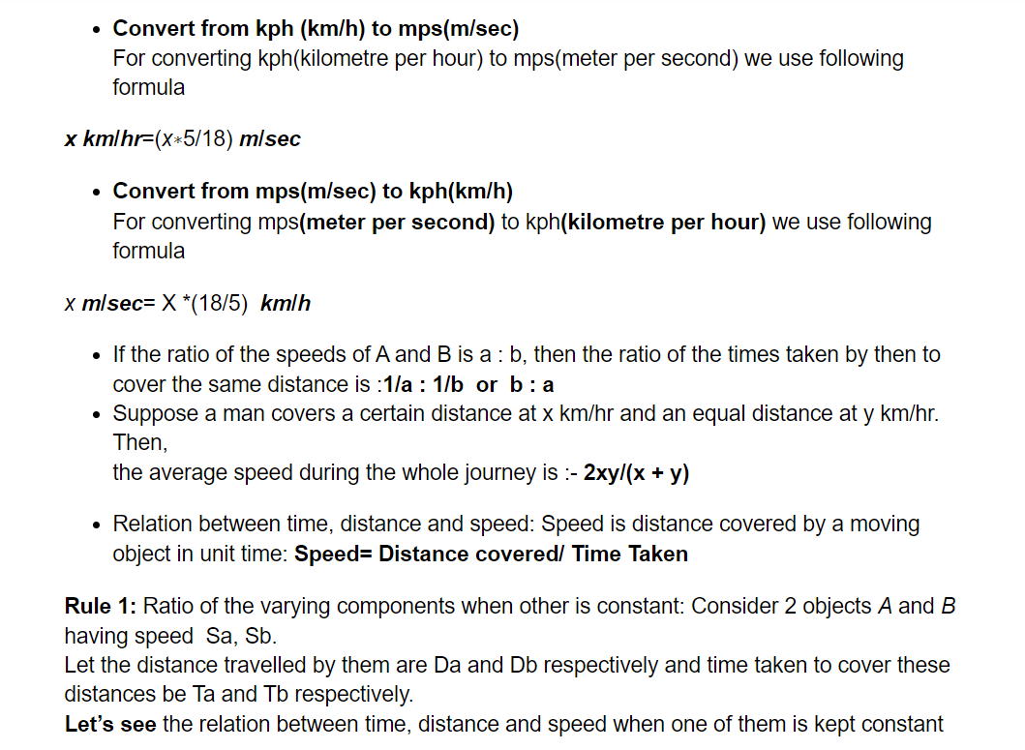
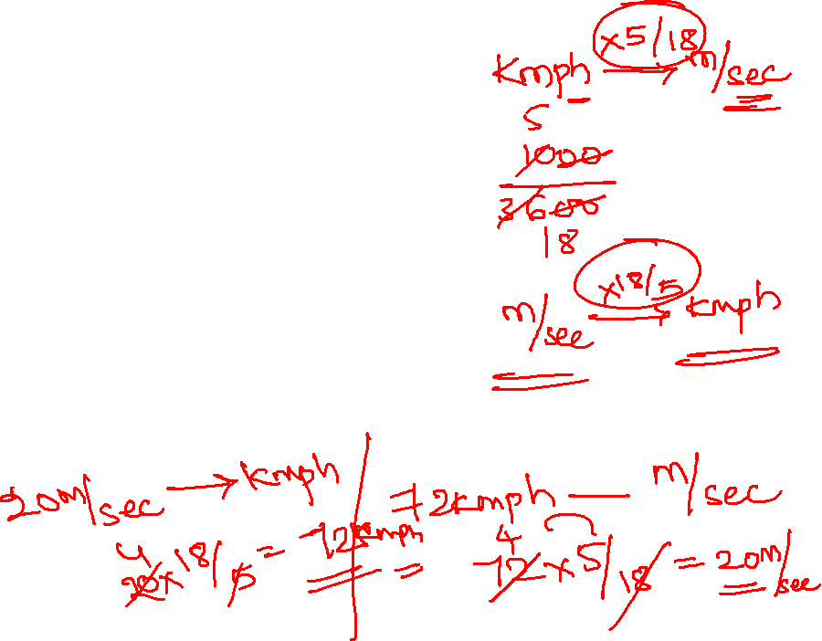

Slide 4
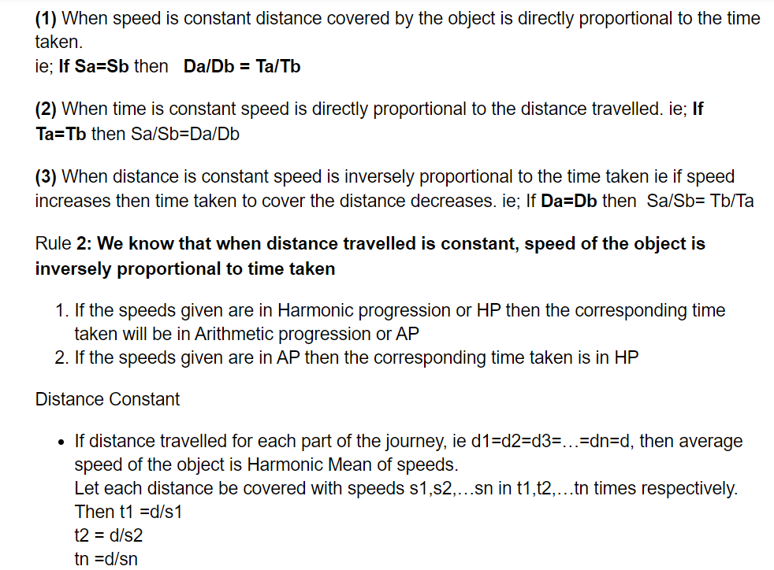

Slide 5
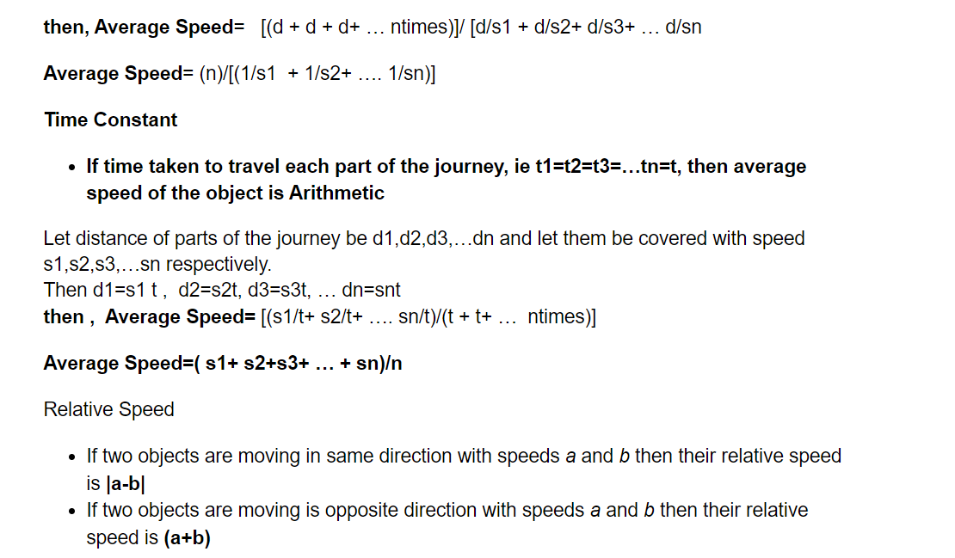
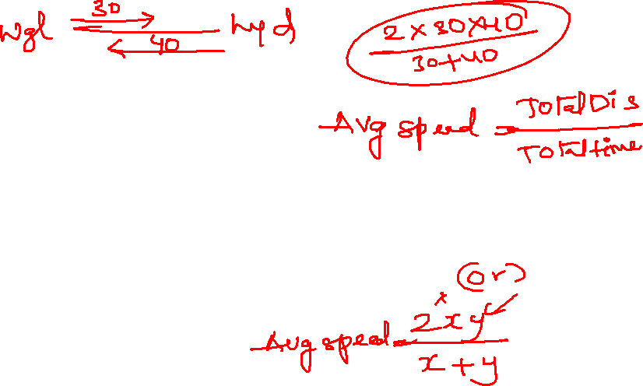

Slide 6
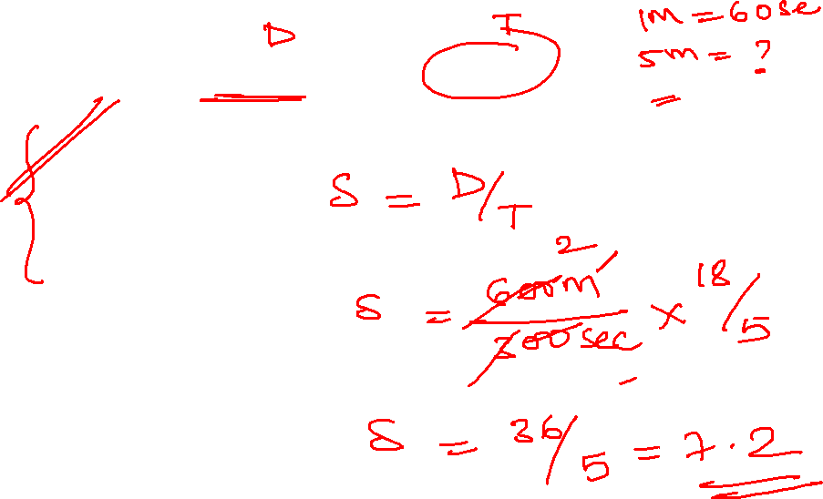
1. A person crosses 600m long street in 5 minutes.
7.2 kmph
6 kmph
9 kmph
12 kmph
Notes:
600m/5*60 sec * 18/5 = 7.2 kmph

Slide 7

2. A train is moving with the speed of 144kmph. Find the speed in m/sec?
40 m/sec
25 m/sec
32 m/sec
28 m/sec
Notes:
144 * 5/18 = 40 m/sec

Slide 8
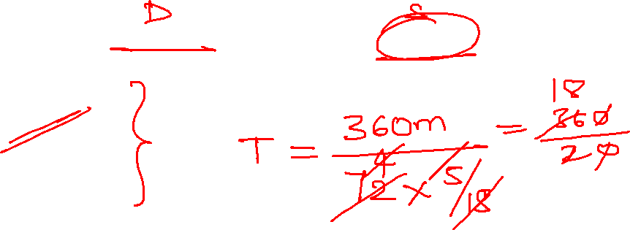
3. A train 360m long, running with a speed of 72 kmph will pass a tree in?
20 sec
18 sec
32 sec
35 sec
Notes:
360m/72kmph *5/18= 18 sec

Slide 9
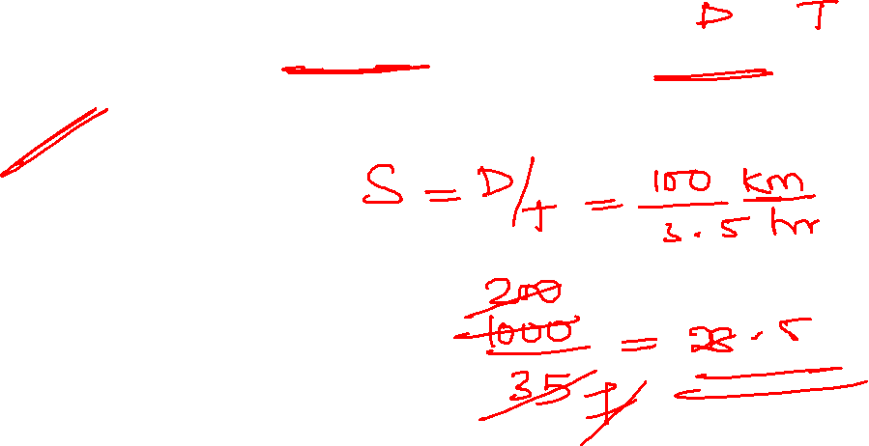
4. At what speed should Alisha drive to cover the distance of 100 km in 3.5 hours
28.5 kmph
18.5 kmph
32.5 kmph
35.2 kmph
Notes:
100km/3.5 hrs = 200/7= 28.5 kmph

Slide 10
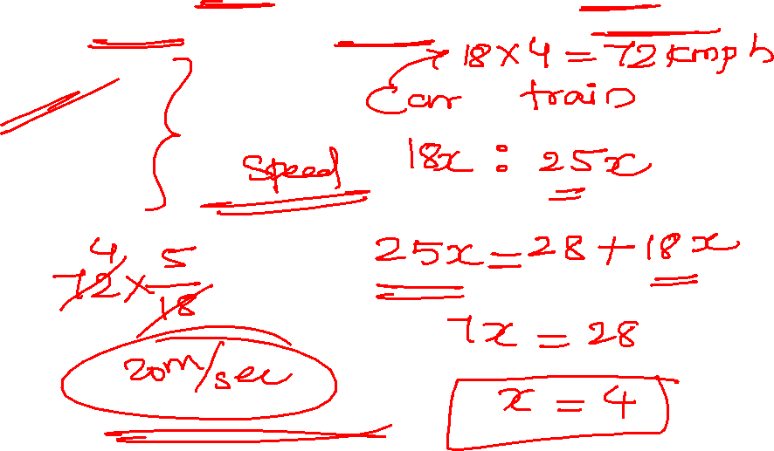
5. The ratio of the speeds of a car and train is 18 : 25. if the speed of the train is 28 kmph more than that of the car, what is the speed of the car?
18 m/sec
20 m/sec
24 m/sec
25 m/sec
Notes:
Car: train= 18:25
7=28 kmph
18=?(72 kmph)
72*5/18 = 20 m/sec

Slide 11
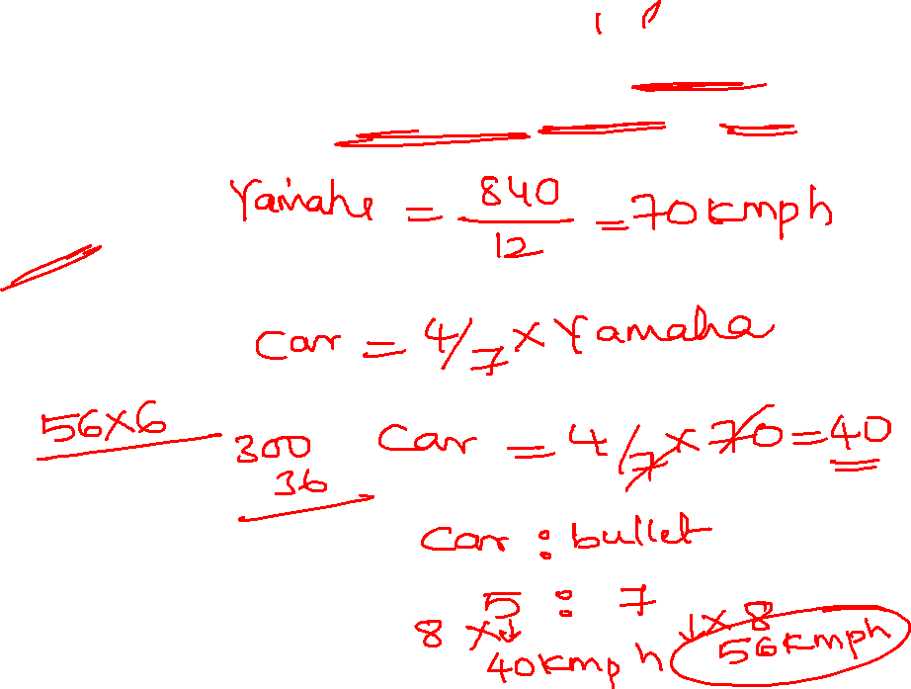
6. The ratio of the speed of a car to that of a bullet is 5 : 7. also a Yamaha covered a distance of 840 km in 12 hours. The speed of the car is 4/7 the speed of the Yamaha. How much distance will the bullet cover in 6 hours
312 km
324 km
336 km
348 km

Slide 12
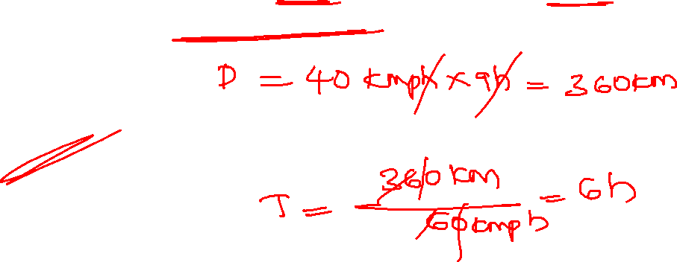
7. A car travelling at a speed of 40 kmph can complete journey in 9 hours. How long will it take to travel the same distance at 60 kmph
3 hours
4 hours
5 hours
6 hours

Slide 13
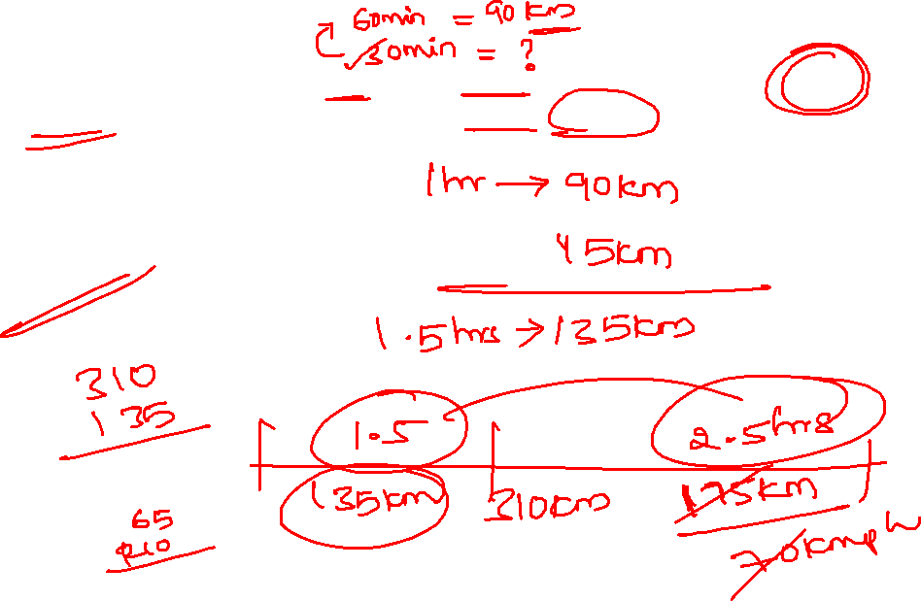
8. A truck travels at 90 kmph for first 1(1/2) hours after that it travels at 70 kmph. Find the time taken by the truck to travel 310 km
6 hours
5 hours
2 hours
4 hours

Slide 14
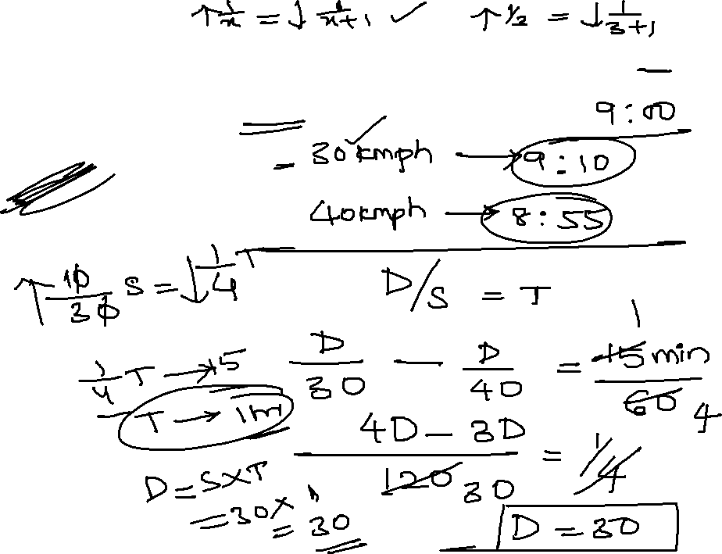
9. A man covers a certain distance between his house and office on a Scooter. Having an average speed of 30 km/hr, he reaches office late by 10 minutes. However,with a speed of 40 km/hr, he reaches his office 5 minutes earlier. The distance between his house and office is
10 km
30 km
20 km
40 km

Slide 15
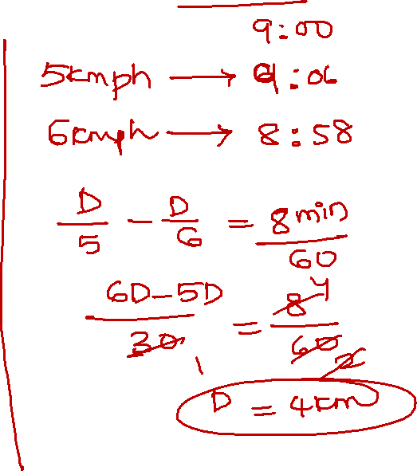
10. A Man walked from his house to office at 5kmph and got 6 minutes late. if he had travelled at 6 kmph, he would have reached 2 minutes early. The distance from his house to office is?
4 km
10 km
20 km
40 km

Slide 16
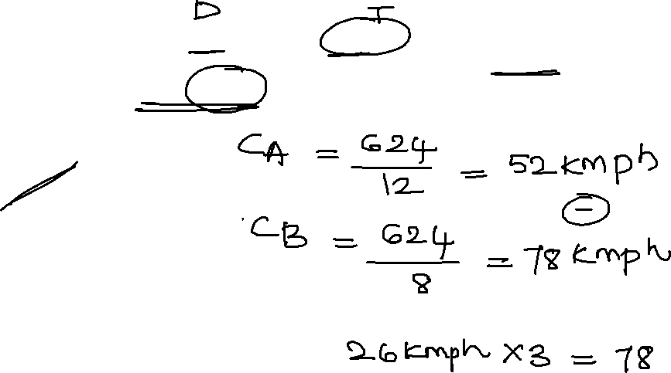
11. Car A covers 624 km distance in 12 hours and another car B covers the same distance in 4 hours less. Find the difference of the distance covered by these two cars in 3 hours, if both the cars are moving in the same direction
68 km
78 km
56 km
65 km
Notes:
Car A= 624/ 12 hr Car B= 624/8
= 52 kmph car B= 78 kmph
relative speed = 78-52= 26*3=78 km

Slide 17
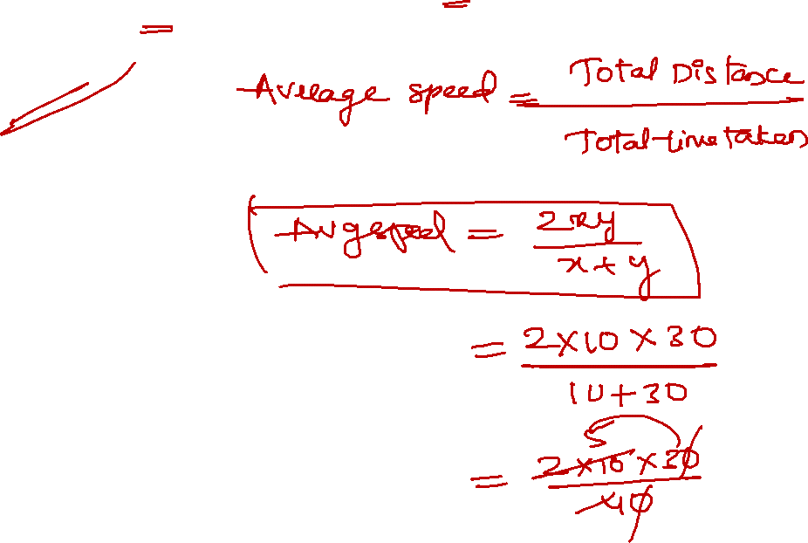
12. Amit travels from A to B at a speed of 10 kmph and came back with a speed of 30 kmph. Find the average speed for the entire journey
20 kmph
15 kmph
30 kmph
18 kmph
Notes:
Average speed = 2xy/x+y
= 2*10*30/ 10+30 = 15 kmph

Slide 18
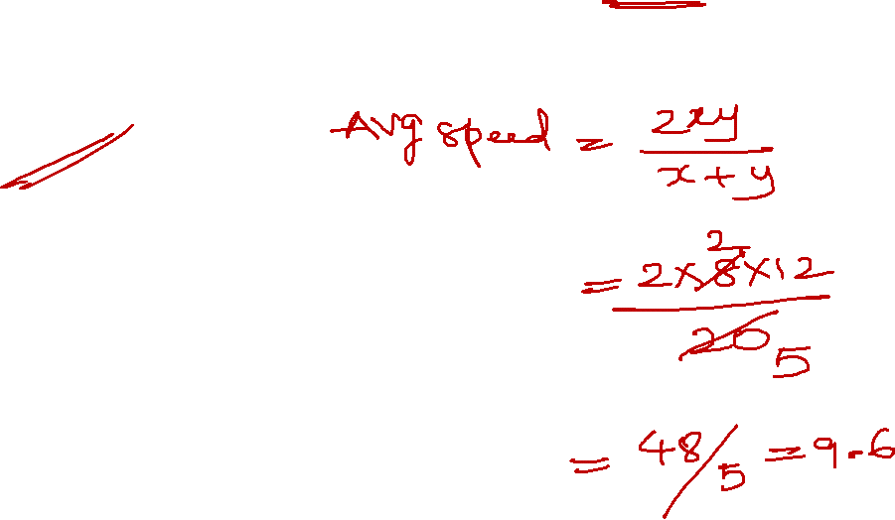
13. What is Ram’s average speed if he goes from point X to point Y at 8 kmph and return from point Y to point X at 12 kmph
8.6 kmph
10.6 kmph
9.6 kmph
15. 6 kmph

Slide 19
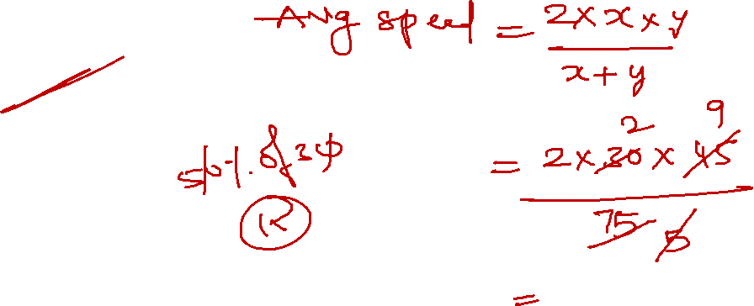
14. A person travel from A to B at a speed of 30 kmph and returns by increasing his speed by 50%. What is the speed of both the trips?
38 kmph
24 kmph
36 kmph
28 kmph

Slide 20
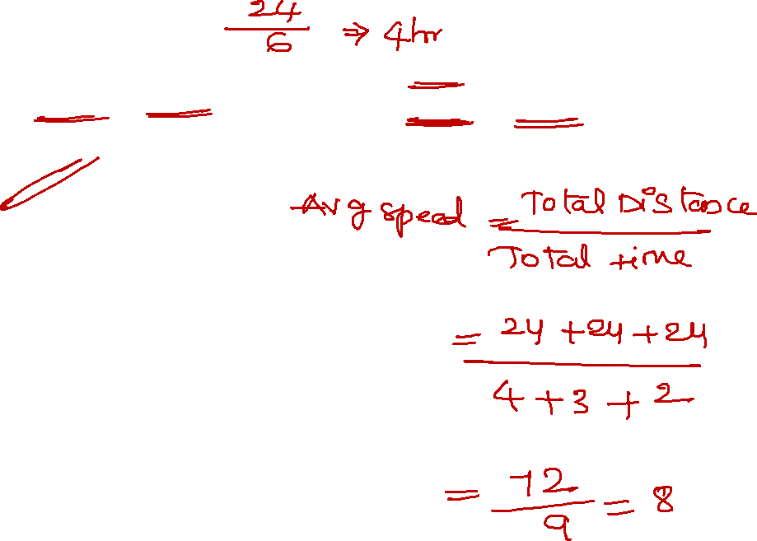
15. A man travels a distance of 24 km at 6 kmph. Another distance of 24 km at 8 kmph and a third distance of 24 km at 12 kmph. His average speed for the whole journey is.
8 kmph
8.5 kmph
9 kmph
10 kmph

Slide 21
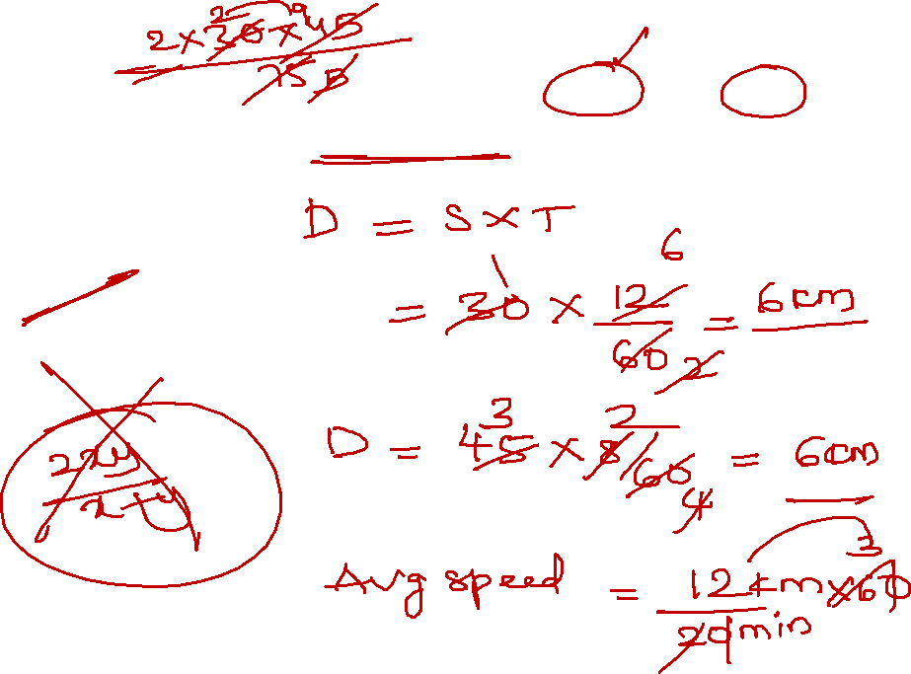
16. A car moves with the speed of 30 kmph for 12 min and next 8 min at a speed of 45 kmph. Find the average speed of the car
38 kmph
24 kmph
36 kmph
28 kmph

Slide 22
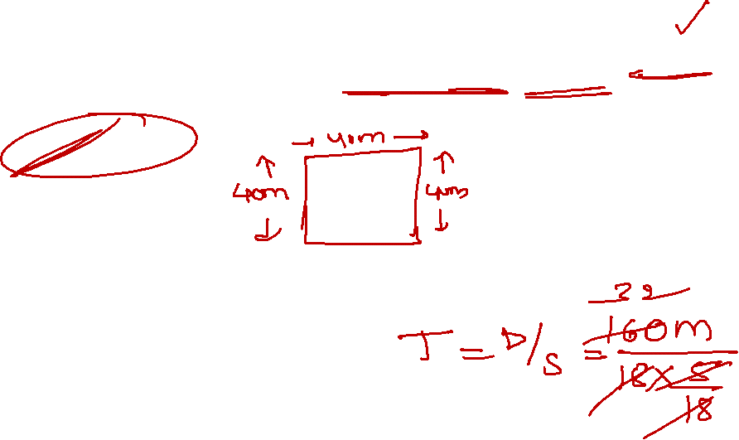
17. A man runs on a square track of 40m in length with speed of 18 kmph. What is the total time taken by him to complete a round track
32 sec
54 sec
56 sec
58 sec

Slide 23
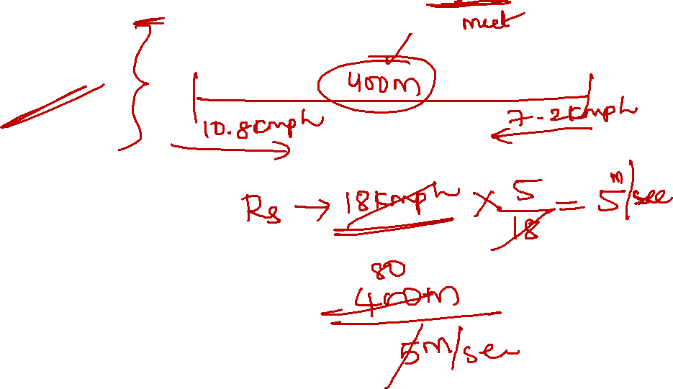
18.Two monkeys are standing 400m a part. First monkey can run at a speed of 10.8 kmph and second run at 7.2 kmph. If two monkeys run towards each other after how much time will they bump into each other?
60 sec
70 sec
80 sec
90 sec
Notes:
10.8 *5/18 = 3 m/sec
7.2*5/18 = 2 m/sec
TIME= 400m/5 m/sec =80 sec

Slide 24
19.A man when increasing his speed from 24 km/hr to 30 km/hr. He takes 1 hour less than the usual time to cover a certain distance. what is distance usually covered by Aman?
120 km
280 km
240 km
400 km
Notes:
Option A

Slide 25
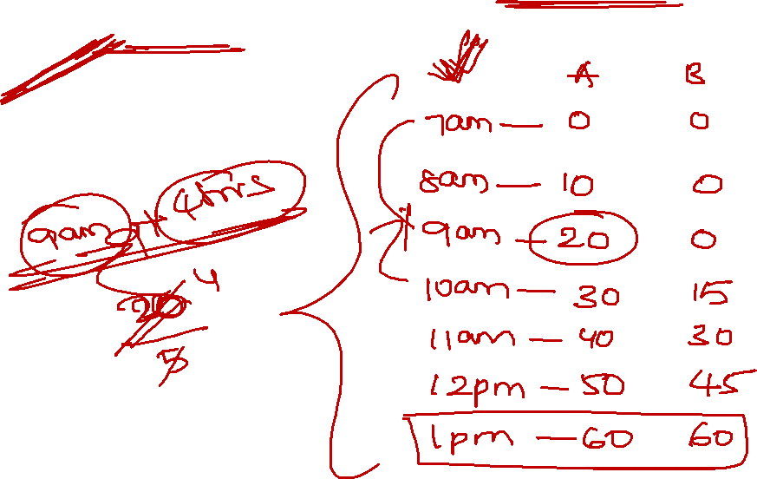
20. A person start walking from a place at 7 am at a speed of 10 kmph. At 9 am B starts from the same place walking in the same direction at a speed of 15 kmph when they will meet?
1 PM
2 PM
3 PM
12:30 PM
Notes:
7 am ---- 9 am = 10kmph *2 = 20 km
20km/5 kmph = 4 hrs
9+4= 1 pm

Slide 26
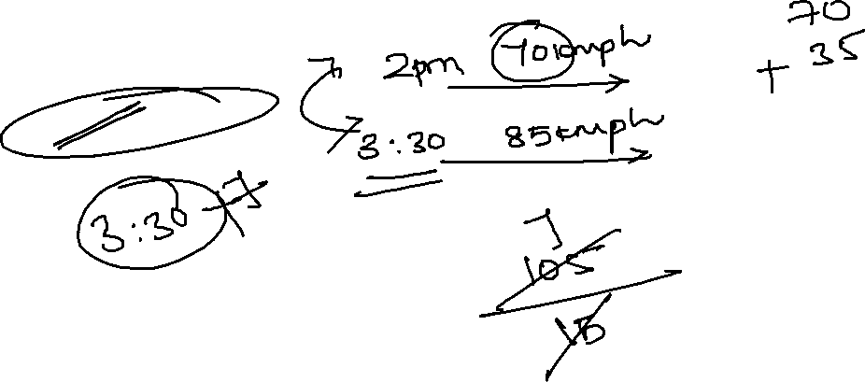
21. A car start travelling from a place at 2 PM at a speed of 70 kmph. At 3:30 PM car B starts from the same place travelling in the same direction at a speed of 85 kmph when they will meet?
1 PM
12: 20 PM
10:30 PM
12:30 PM
Notes:
2 pm ------ 70 kmph
3:30 ------- 85 kmph
2pm—3:30 --→ 1:30hrs distance – 105 km
Time = 105/15= 7 hrs
3:30+7= 10:30

Slide 27
22. A man travelled from P to Q in 7 hours. He travelled one-fourth of the distance at a speed of 10 kmph and the remaining distance at the speed of 12 kmph. Then find the distance between P and Q
75
80
79.25
81.25
Notes:
Let distance= x km
x/4 / 10 = x/40 hrs
3x/4 / 12 = x/16 hrs
x/40 + x/16 = 7
X= 80 kkm

Slide 28
23. A man completes a journey in 10 hours. He travel first half of the journey at the rate of 21 kmph and second half of the journey at 24 kmph. Find the total journey in km
220 km
224 km
230 km
234 km
Notes:
Let total distance – x km
½ x/ 21 + ½ x/ 24 = 10 hrs
½ (x/21+ x/24)= 10 hrs
8x+7x/ 168= 20 hrs
X= 20*168 / 15= 224 km

Slide 29


